Slide 1

TM
Notes:
Introduction should focus on the fact that our team has come up with this idea during/after our international travels; specifically in China. Where we have discovered a large disconnect between what Chinese culture considers normal and just how different this was from the American things we are used to. This was something we noticed translated greatly in China but even more so for the Chinese here in the United States; who come to this country alone with very little to prepare them for this world. They don’t have much to go on, let alone do. Especially in regard to what they consider as entertainment and what Americans do for entertainment.
And thus we get to today’s topic: CUBE KARAOKE LOUNGES

Slide 2



GROWING MARKET OPPORTUNITY
CHINESE INTERNATIONAL STUDENTS
IMG SOURCE: veer.com
IMG SOURCE: veer.com
INCREASINGLY
WEALTHY
INCREASINGLY
GLOBAL
CULTURALLY
UNIQUE
Notes:
Chinese International Student populations are growing by 17% annually. They have grown by 355% since 2006, contributing to record breaking numbers in excess of 200,000 students actively enrolled throughout the United States in 2014 alone; of which Ohio is ranked 8th in attracting their attention.
Now these students are not just coming here but they are increasingly wealthy as well. They represent the wealthiest 1% of their nation and their spending habits reflect this very much.
The CIS Market is not just another influx of temporary consumers. It is a niche population that exhibits strong signs of continued growth
HERE WE NEED TO HIGHLIGHT GROWTHRATES AS A RECENT DEVELOPMENT POISED TO CONTINUE, bringing even more consumers to the US and into our primary market. THIS OPP IS GOING NOWHERE, it is growing
Sample Script:
First, they are INCREASINGLY WEALTHY. Recent booms in China are creating larger populations of consumers with significant spending power.
INCREASINGLY GLOBAL = A trend amongst these affluent families that is worth noting, is their increasing propensity towards International Education … Affluent generation of youngsters with budgeted income towards entertainment have been emerging recently with exponential population growth, excellent forecasts, and strong internal sentiment that favors International Education (especially US)
DISTINCTLY UNIQUE enough to be UNDERSERVED = CIS are a segment unique enough to create opportunity for those who understand but room for folly for those who fake to understand.
-=-=-=-=-=-=-=-=-=-=-=-=-=-=
THIS SLIDE IS ALL ABOUT – presenting the CIS as an emerging market of notable interest with the money to back up small populations yet large market success.
…SHOWCASING MARKET STRENGTH AND VALIDATING CIS AS A TARGET MARKET…
… THIS IS A MARKET WORTH EXPLORING
Recent Development in the Global Market

Slide 3
MARKET PROBLEM
American bars fail to accommodate
Chinese International Students
Notes:
CUBE has been designed to address a very specific problem within a niche market as it is very apparent to us that no current market players within the entertainment industry are doing a good job at capturing this market’s attention.
In fact, THEY FAIL TO DO THIS ON A FUNDAMENTAL LEVEL – leaving hundreds of thousands of students across the United States without viable entertainment options.
HERE IS WHERE WE CREATE AN EXAMPLE THAT ARTICULATES THIS IS A VISIBLE AND PAINFUL NEED WORTHY OF ADDRESSING IN A PRESENTION BUT EVEN MORE IMPORTANT WORTHY OF LISTENING TO FOR THE NEXT 12 MINUTES – THE NEED TO BE HEARD, in a country where they are traveling, in a world that is more global each day – the market is not responding.

Slide 4
Appeal to the Chinese consumer at a cultural, social, and emotional level
MARKET SOLUTION
BRING KTV TO AMERICA
Notes:
A specially tailored entertainment experience that appeals to the Chinese consumer at a cultural, social, and emotional level. = also known as ktv = is a concept that focuses on small group entertainment rather than large public gathering

Slide 5
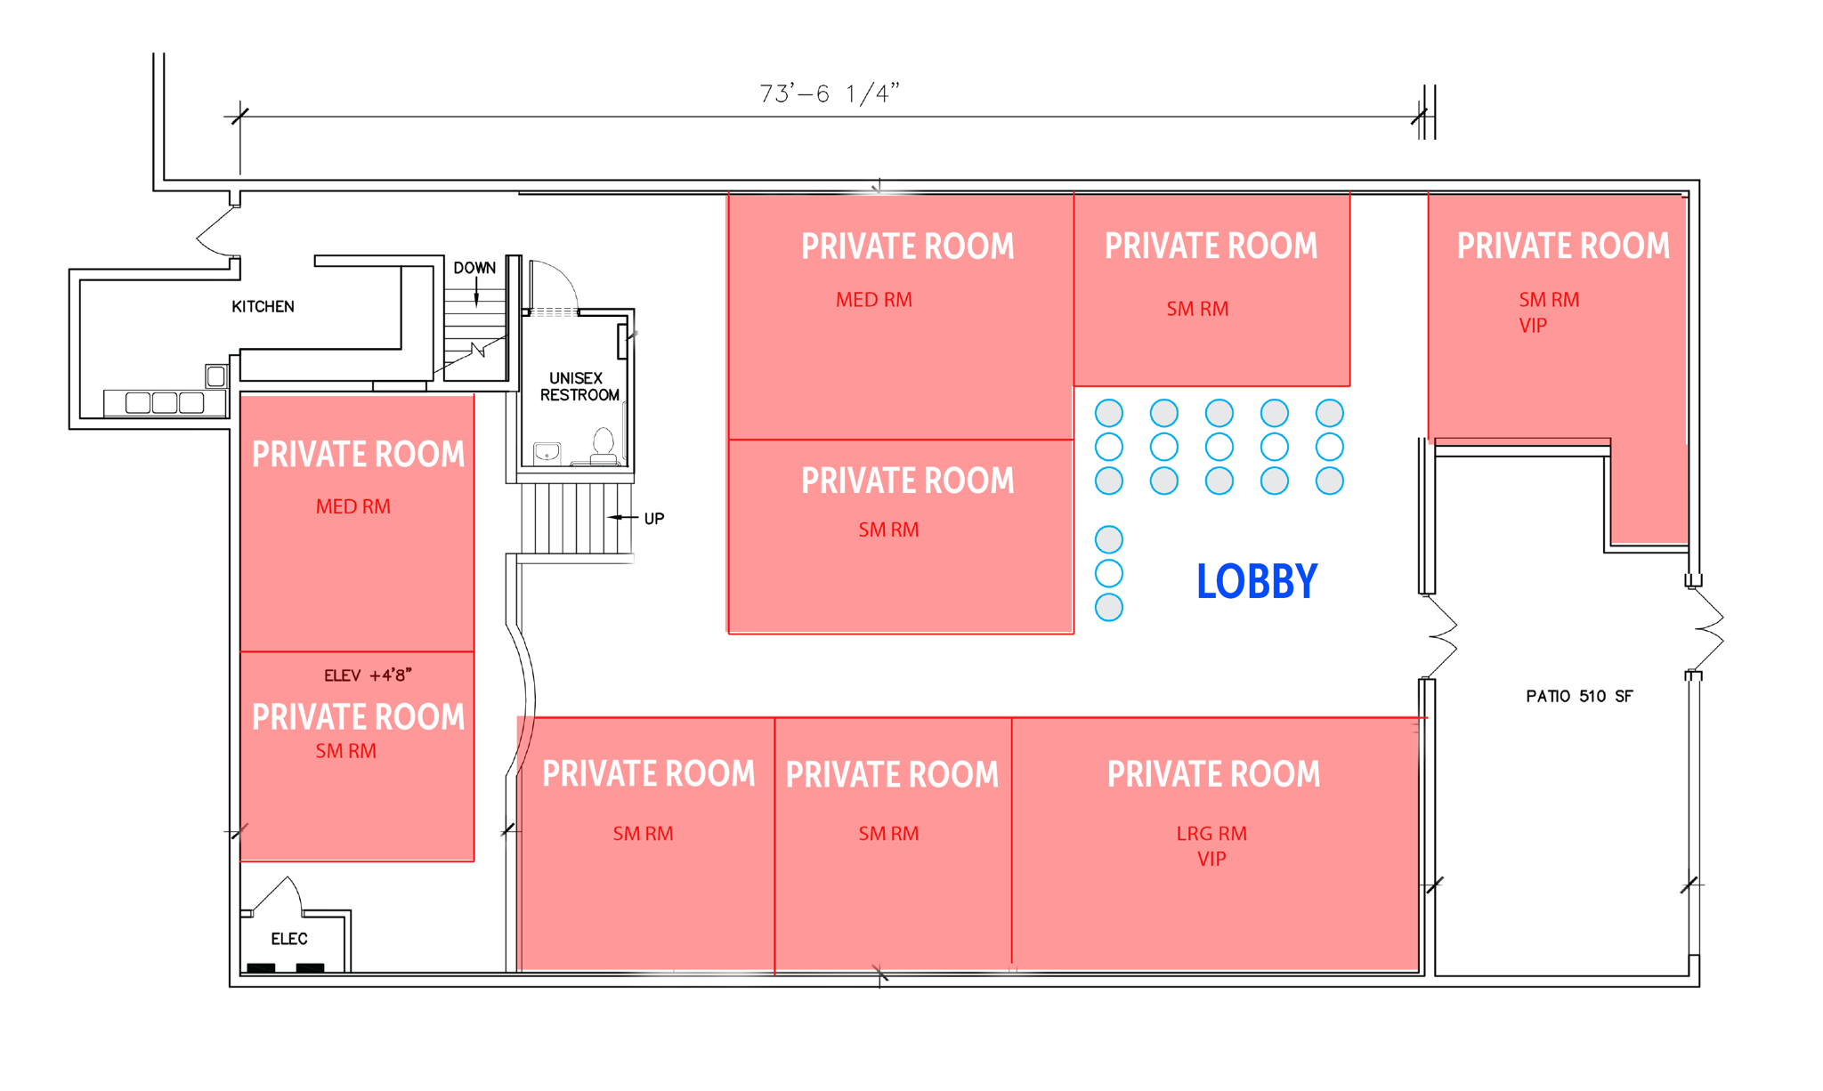
MARKET SOLUTION
KTV FLOORPLAN
Notes:
This concept hinges on the provision of various sized rooms available for hourly rent at a premium.

Slide 6
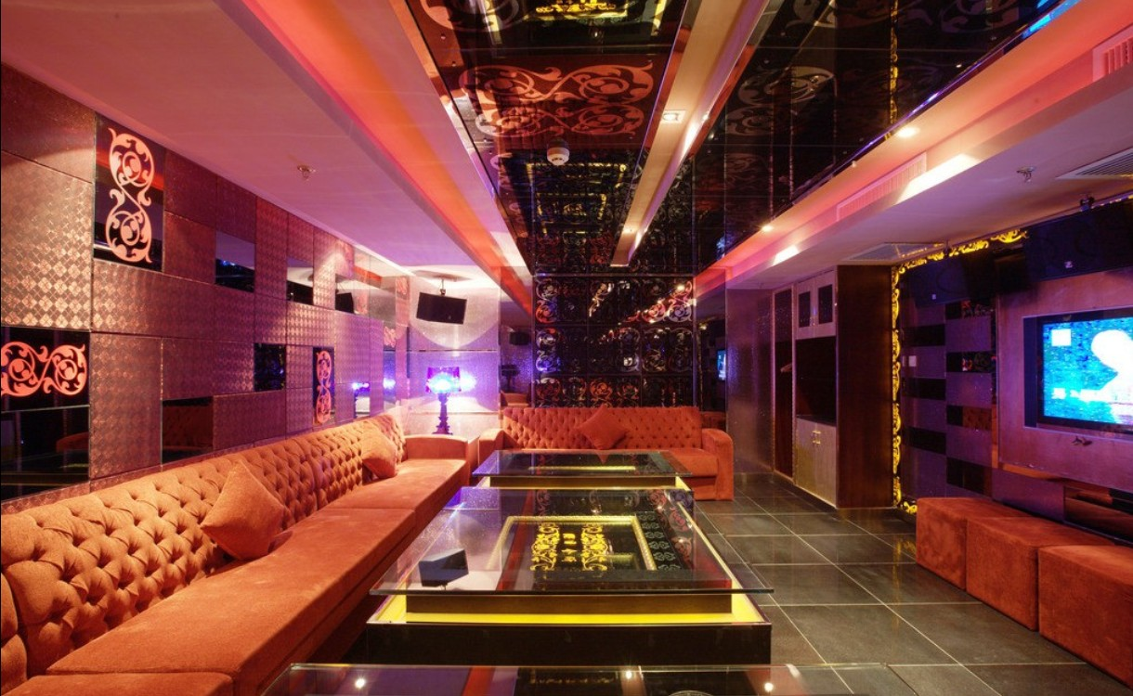
MARKET SOLUTION
RENT PRIVATE ROOMS
IMG SOURCE: download3dhouse.com/
Notes:
These rooms provide the amenities of any other public area, but with the luxury of control and the convenience of personalization.

Slide 7
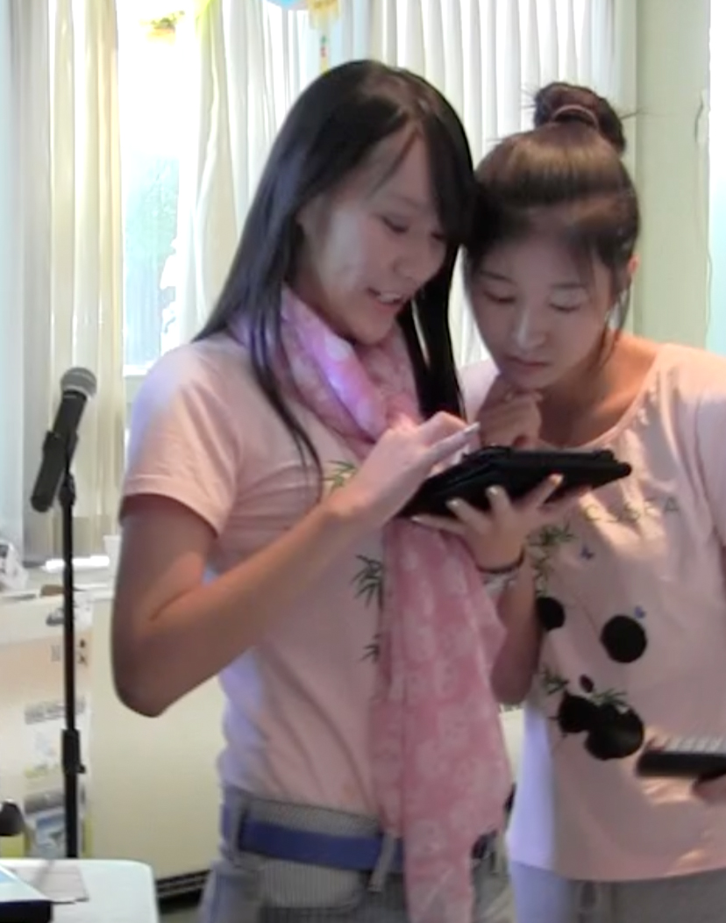
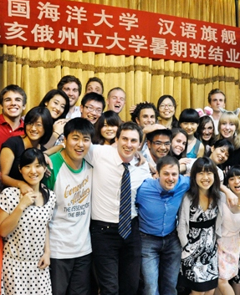
TARGET MARKET > $8 MILLION
COLUMBUS, OH
3500
CHINESE
INTERNATIONAL
STUDENTS
IMG SOURCE: oia.osu.edu
500
CHINESE
LANGUAGE
STUDENTS
Notes:
The target market for this opportunity is estimated at 4,000 students with statistics estimating current market value at 8 million
CHINESE INTERNATIONAL STUDENTS (CIS) = 3,520
CHINESE SECOND LANGUAGE (CSL) STUDENTS ~ 500

Slide 8
MARKET > 8 MILLION USD
1) Gather Data / Assumptions
Expected Pricing
Avg. Hours per week
Avg. Spending per Customer - Day
Avg. Spending per Customer - Night
2) Estimated Market
$1.43 (MILLION USD) / 15% (MARKET SHARE)
= 9.54 MILLION $ MARKET
Notes:
8 Month University Calendar
$178,861 Monthly Revenue
$1.43 Million Yearly Revenue

Slide 9


PRODUCT/SERVICE OFFERING
PREMIUM
SPIRITS
PRIVATE ROOM
RENTAL

Slide 10
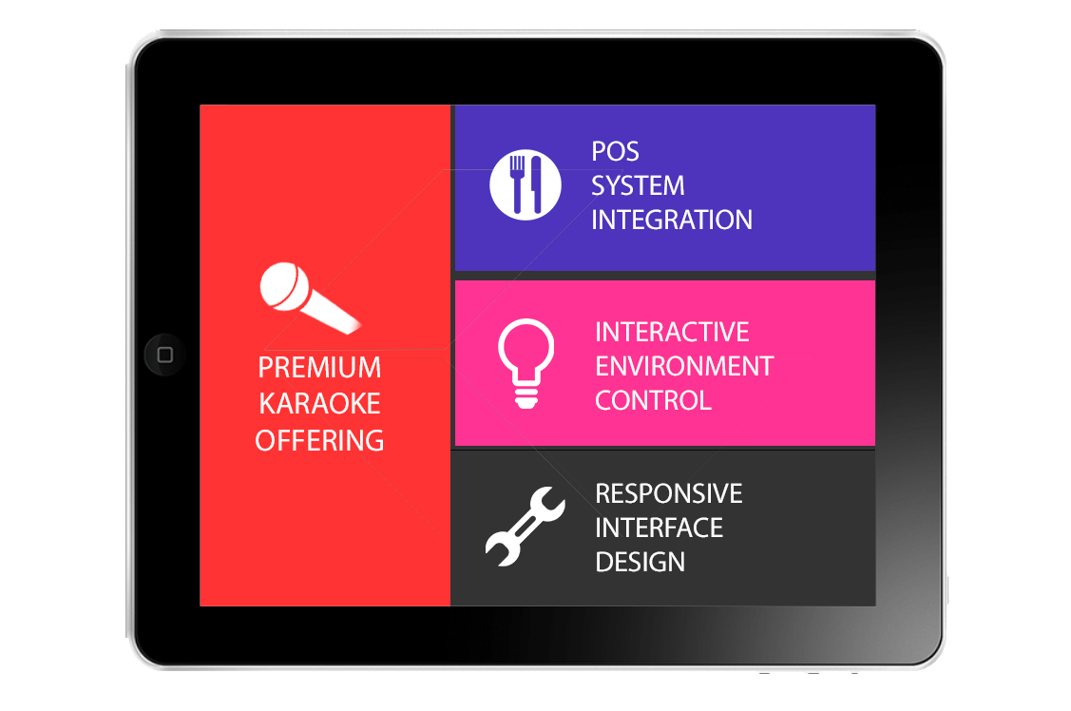
PRODUCT/SERVICE OFFERING
iPAD INTEGRATED OPERATIONS
Notes:
Add Technological Components
How does it add to the experience

Slide 11
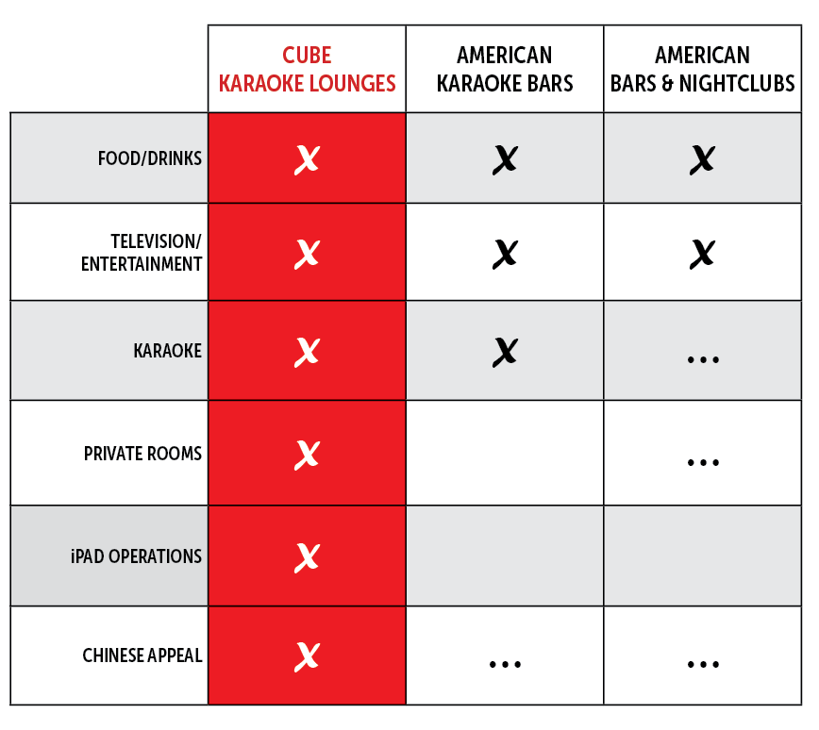
UNIQUE VALUE PROPOSITION
Notes:
Info graphic reflecting why current industry solutions are not meeting these needs is a fundamental failure rather then a simply adjustable nuance.

Slide 12



MARKETING STRATEGY
BUILD RELATIONSHIPS
Ohio State Administration
Student Organizations
National Organizations
Local Asian Community
Local Business Community
Notes:
with local organizations, communities, Asian supermarkets, soccer leagues, online communities, social media networks, etc.

Slide 13




MARKETING STRATEGY
DIRECT PROMOTIONS
Asian Markets
Asian Restaurants
Port Columbus International Airport
OSU Advertising Channels
Student Publications
Social Media

Slide 14
Management and Organization
Diverse Advisory Board
Strategic Local Partnerships
Key Hire: General Manager
Notes:
This idea is capable of extensive entrepreneurial success and management/operations has been tailored for this venture specifically.
Mention Kierra, tpayne, nicco, our Chinese investors, etc, everyone
Linking everyone toward a specifically designed approach to this customer, at this time in the market, with these resources, in the locations we have chosen.
Nothing is by accident. If we shaded something or included a phrase, it is because we have agreed this is the best idea on the table; customers and owners alike.

Slide 15
START-UP TEAM
International Business Experience (China)
Multi-industry Background
Working Together for 15 months

Slide 16
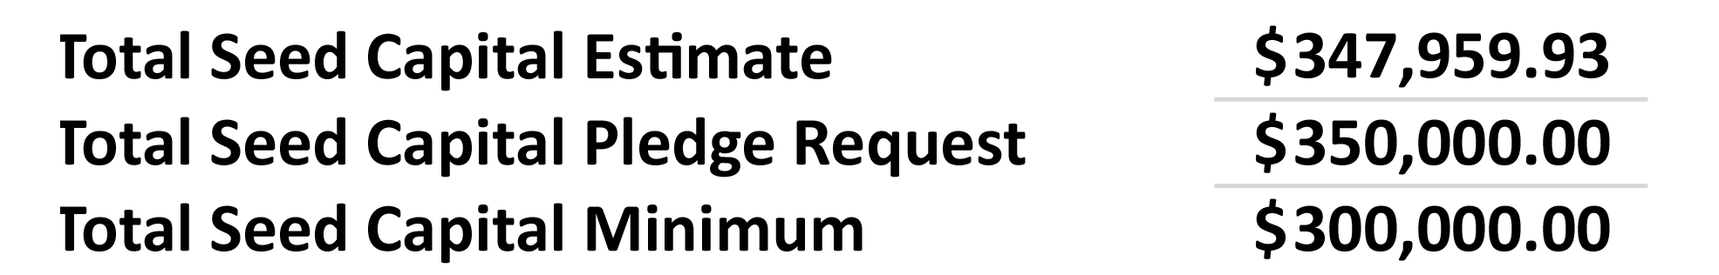
FUNDING REQUIREMENTS
Total Seed Capital Raised
$341,000
Notes:
WHAT WILL THIS COVER? – HOW DID WE COME UP WITH THIS?? – JUDGES EXPRESSED INTEREST IN WHERE IS THIS MONEY GOING AND WHY WE THINK ITS ENOUGH/CORRECT
Both need to be addressed and the 350k needs to be heard, understood and accepted as a fact before we move on

Slide 17
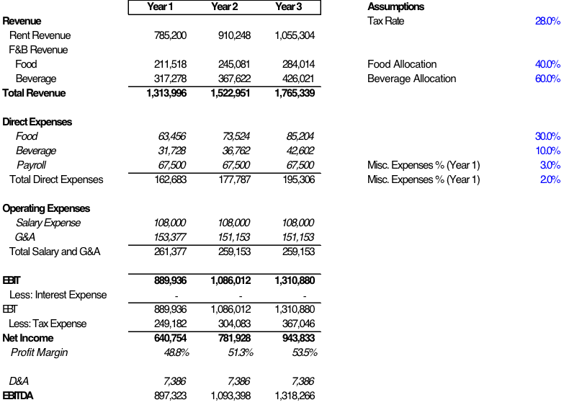
FINANCIAL PROJECTIONS
Notes:
WE NEED MORE DATA HERE
Extended Revenue Streams
Total CIS Entertainment Market (Columbus, OH) - 8 million USD
Market Share Projections: 15%

Slide 18
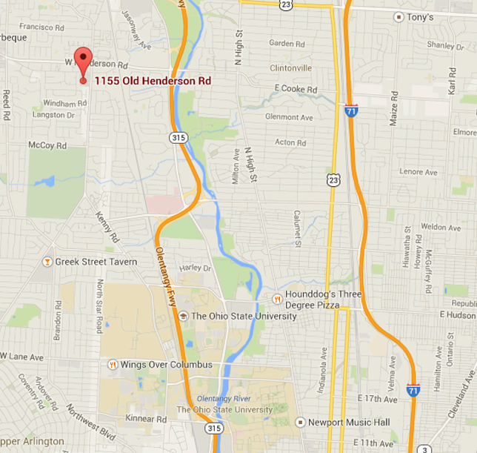
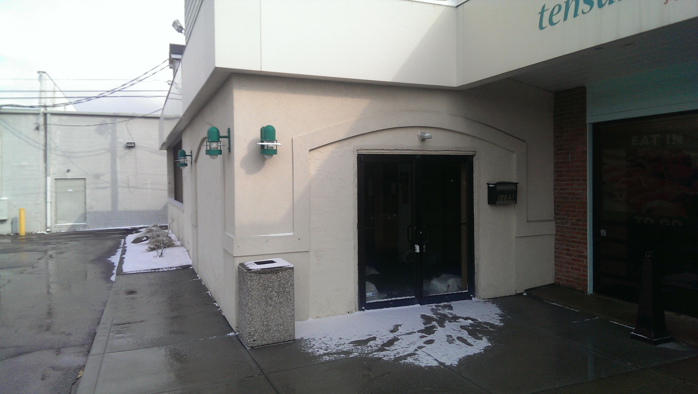
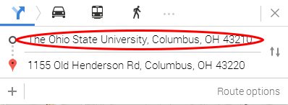
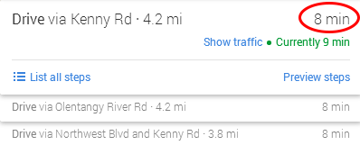
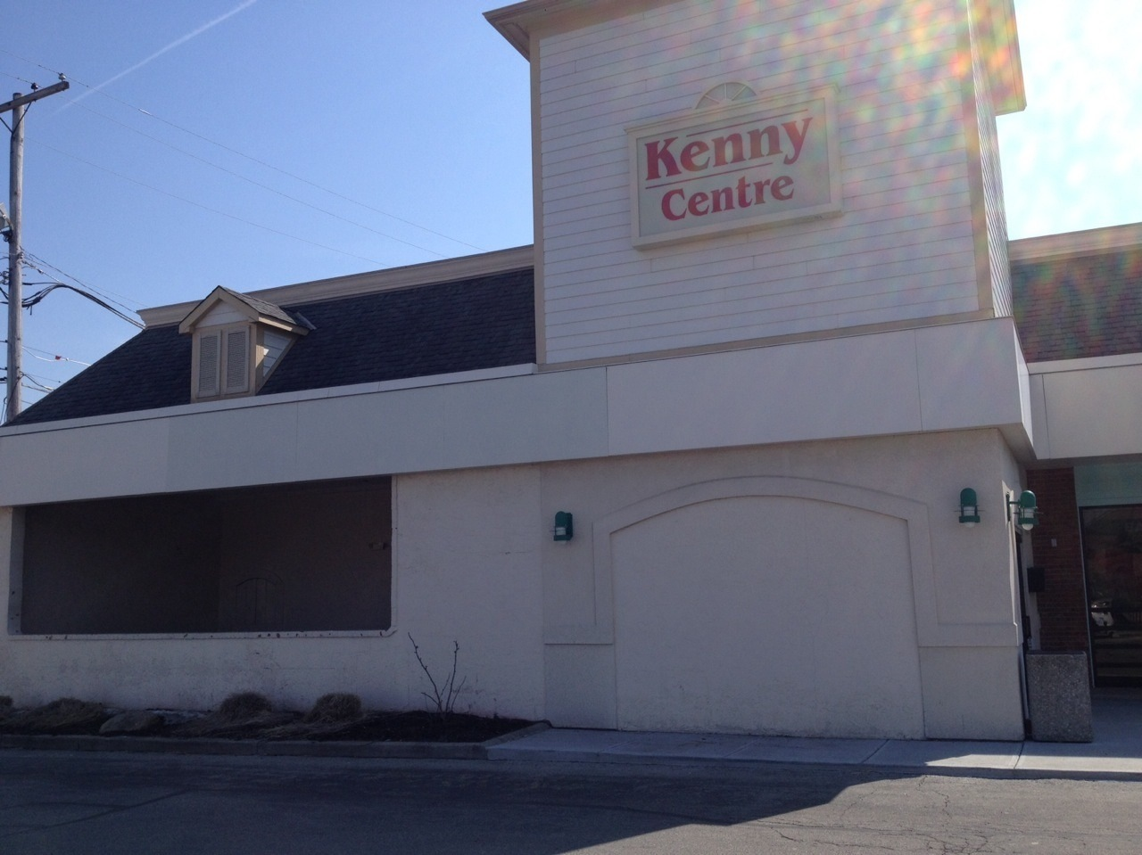

IMPLEMENTATION
SIGNED COMMERCIAL LEASE
IMG SOURCE: Google Maps
April 2014- Pre Construction
September 2014- Grand Opening
Notes:
Full Seed Capital Raised – 7/13
Formed CUBE Karaoke Columbus LLC- 7/13
Software Testing Began- 8/13
Signed Commercial Lease- 3/14
Construction Begins- 4/14
Grand Opening- 9/14

Slide 19
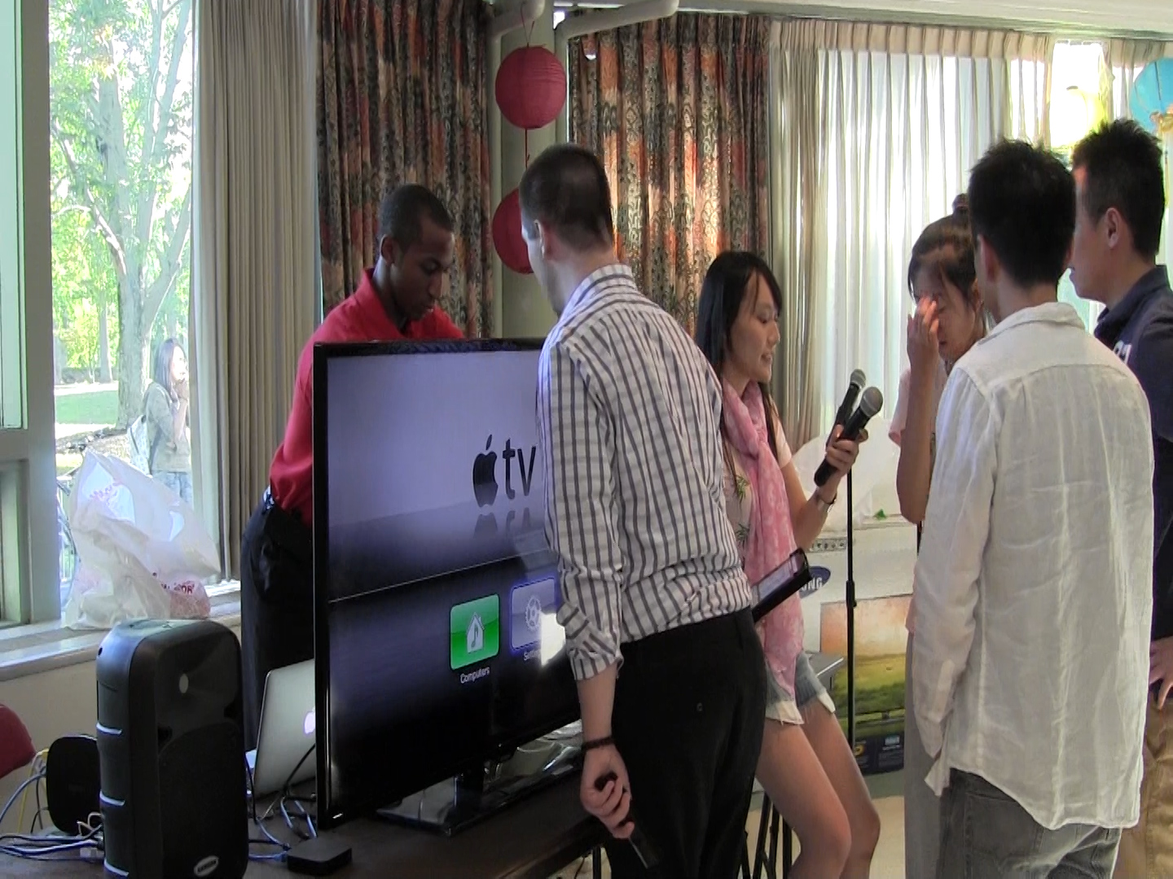
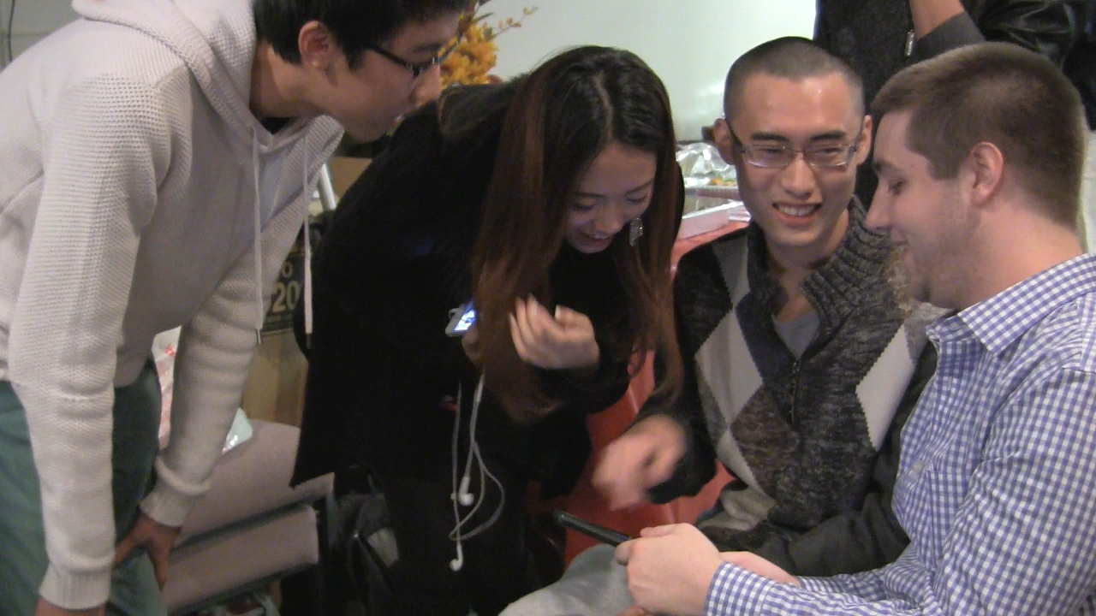
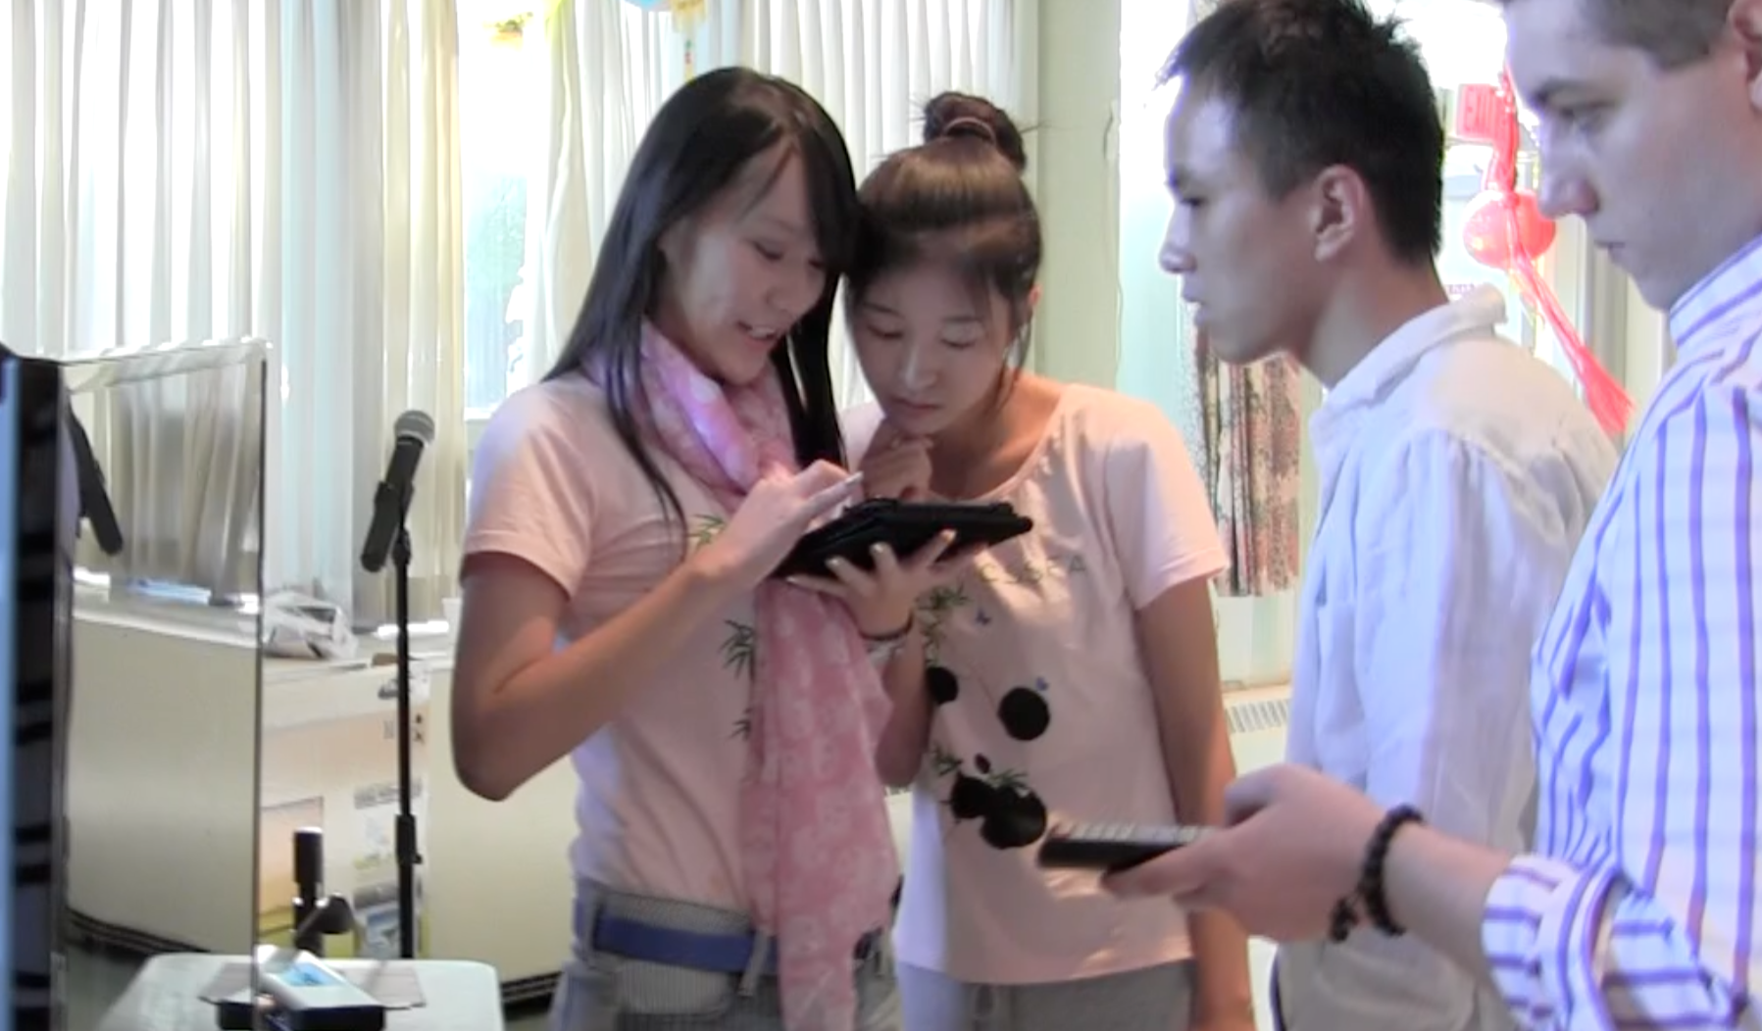
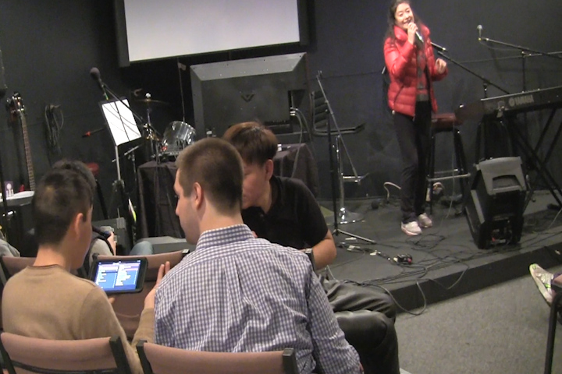
IMPLEMENTATION
TESTING
Notes:
Full Seed Capital Raised – 7/13
Formed CUBE Karaoke Columbus LLC- 7/13
Software Testing Began- 8/13
Signed Commercial Lease- 3/14
Construction Begins- 4/14
Grand Opening- 9/14

Slide 20
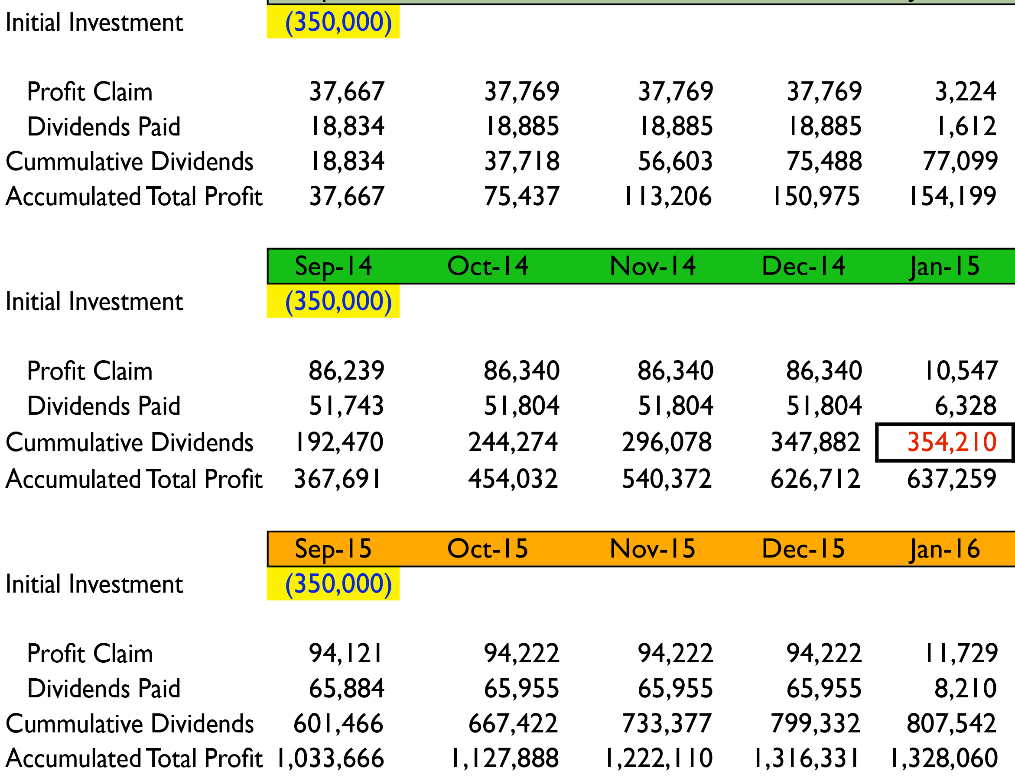
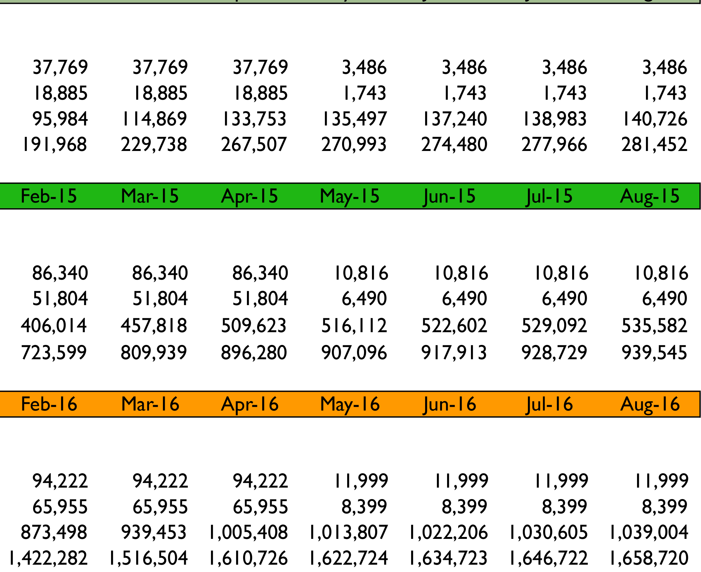
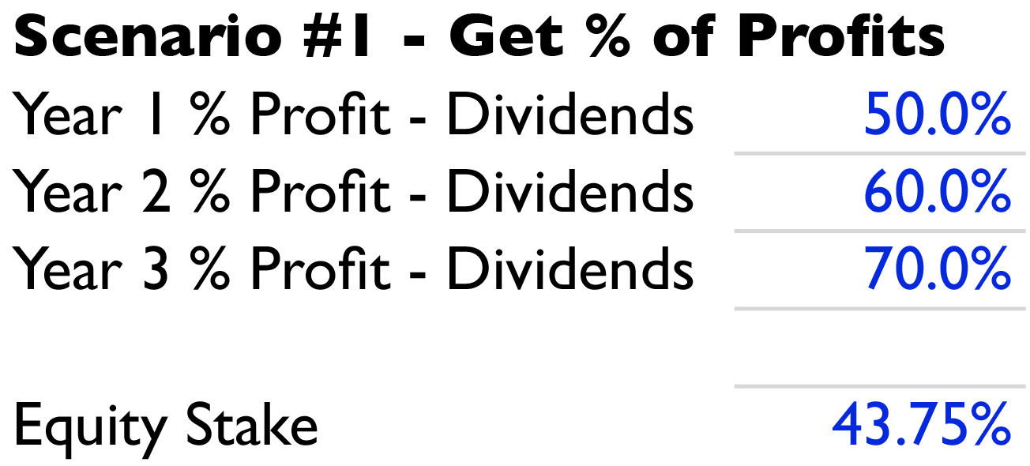
EXIT STRATEGY
Year One
Year Two
Year Three

Slide 21

TM

